Slide 1
CSpro5.0
CSPro, short for the Census and Survey Processing System, is a public domain statistical package developed by the U.S. Census Bureau and ICF International. Cspro is used by DHS(demographic health survey) for data analysis.

Slide 2
How it works?
We can create forms same as our survey .
Fill the form in its original form.
Calculate frequencies for the data.
Export data to be analyzed .
Exported data could be used by excel, stata, spss, sas for statistical analysis.

Slide 3
Creating forms base
Add record corresponding to each section.
Create data fields for each question as defined in your survey.
Define value sets for each question and corresponding number for each option.

Slide 4
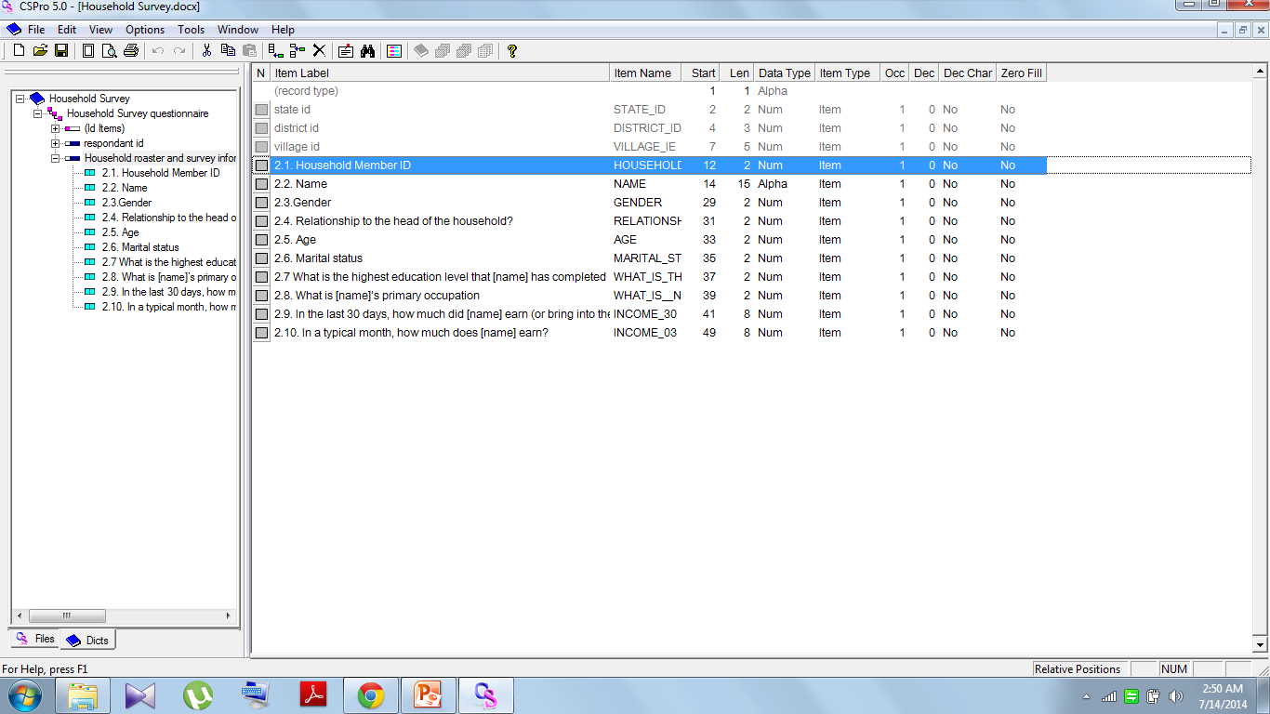
questions

Slide 5
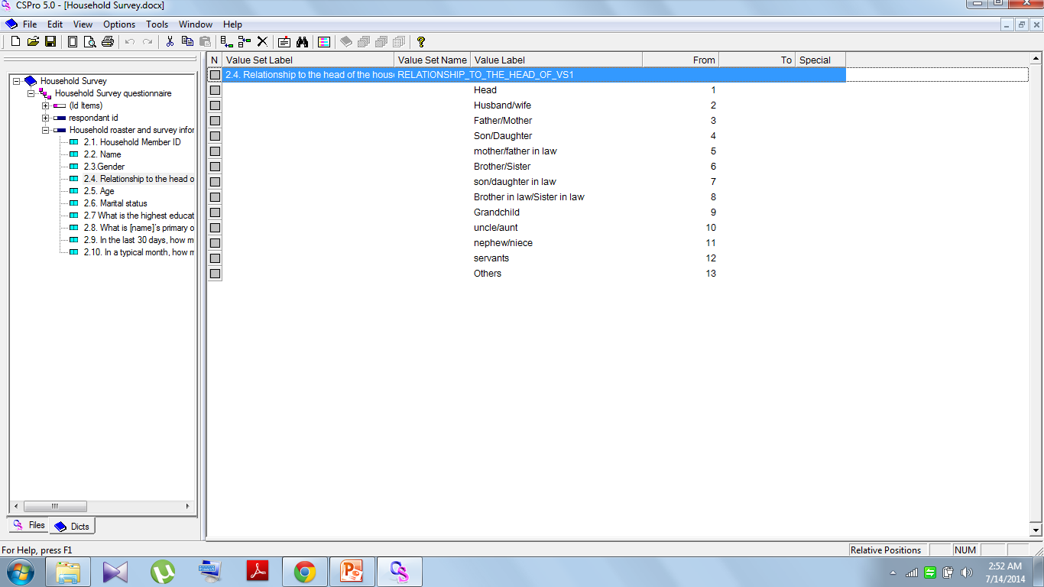

Value sets

Slide 6
Creating forms
Create forms and edit to get it as precise as the original survey

Slide 7
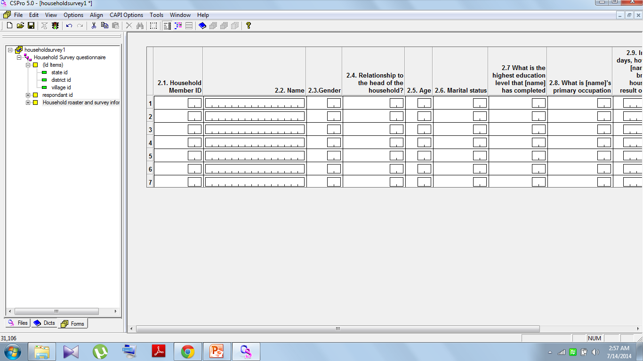

Slide 8
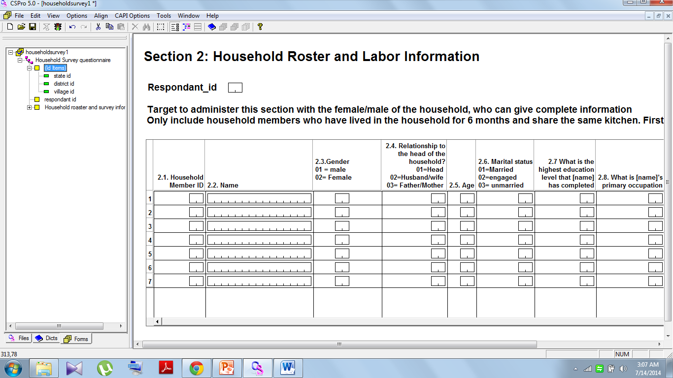

Slide 9
Data entry
We can fill the form as it is as many number of times .
Each data entry will be saved as a different entity to be edited in later stage.
All data files could be merged together for data analysis.
Operator id specifies who is entering the data.

Slide 10
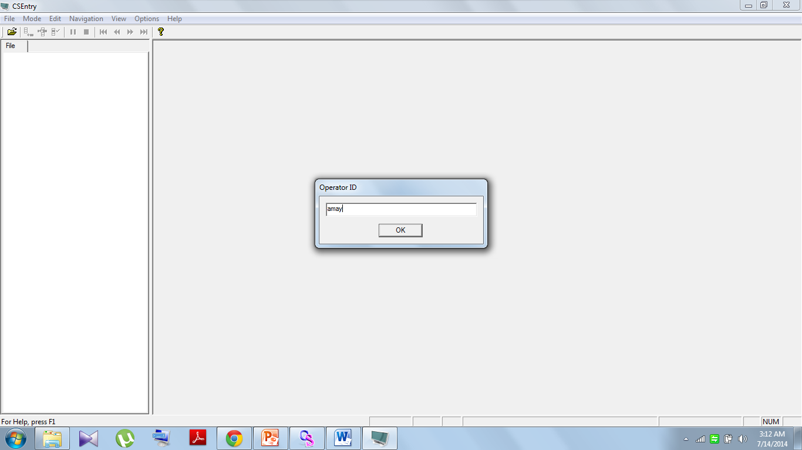

Slide 11
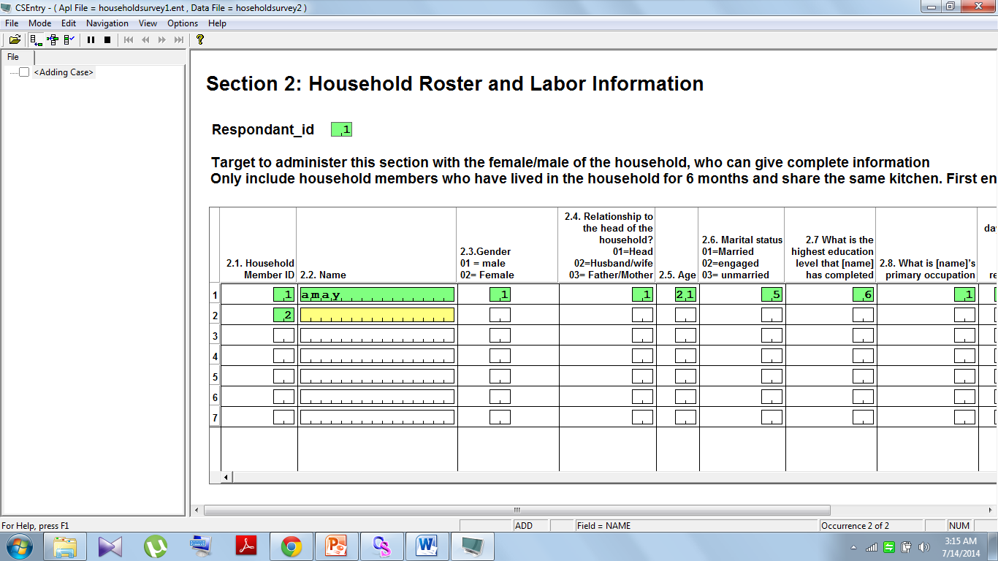

Slide 12
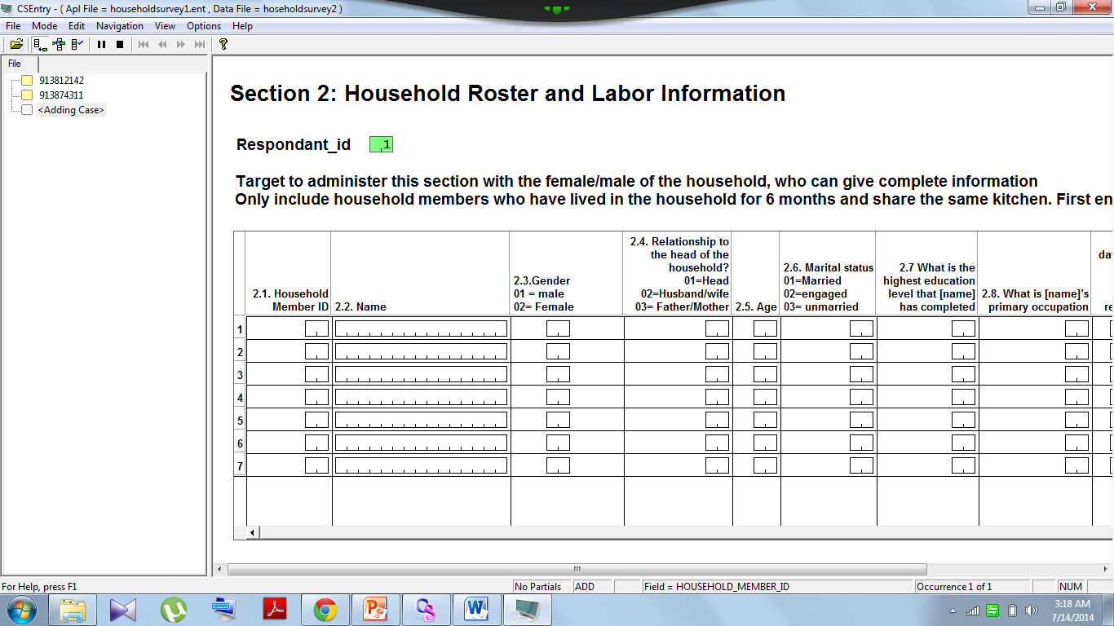
Added cases

Slide 13
Analyzing data
Frequency tables can be created within cspro.
Data can be exported to be analyzed manually as text file or could be exported in formats for tools like stata, spss, sas, excel.

Slide 14
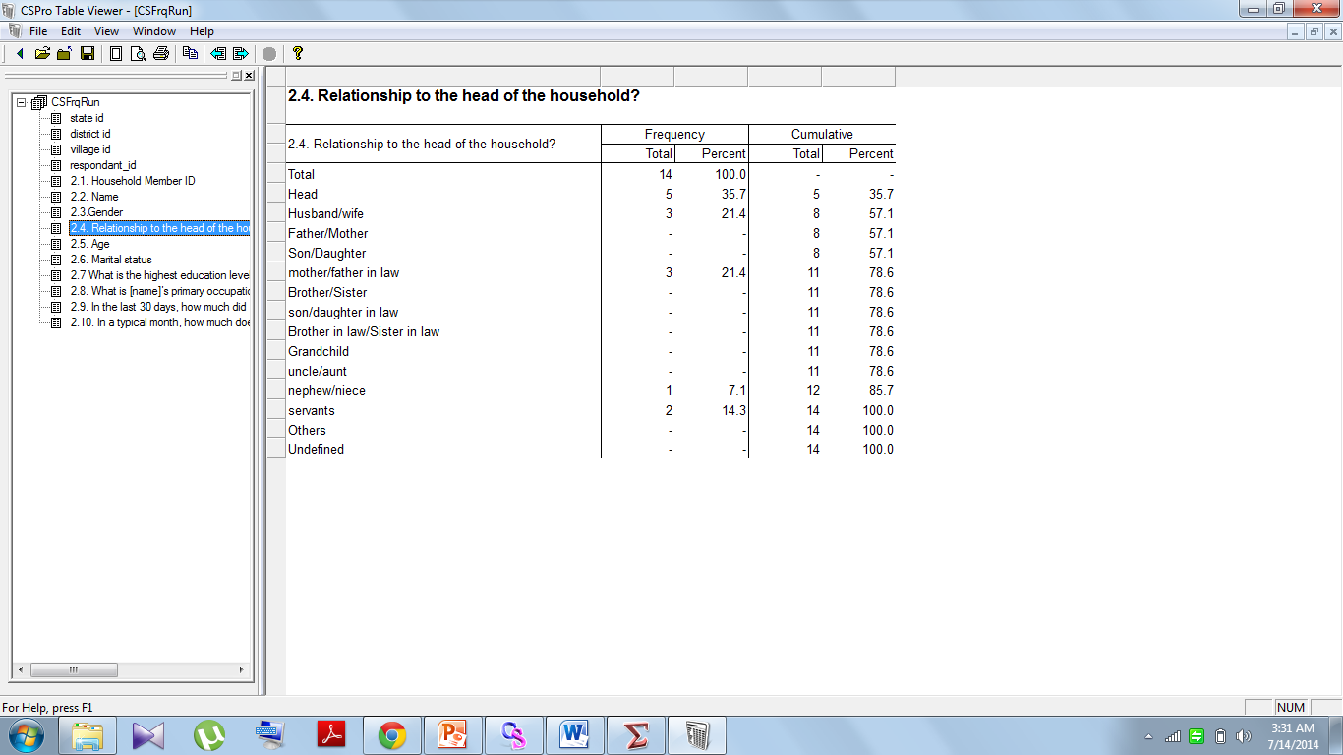

Slide 15
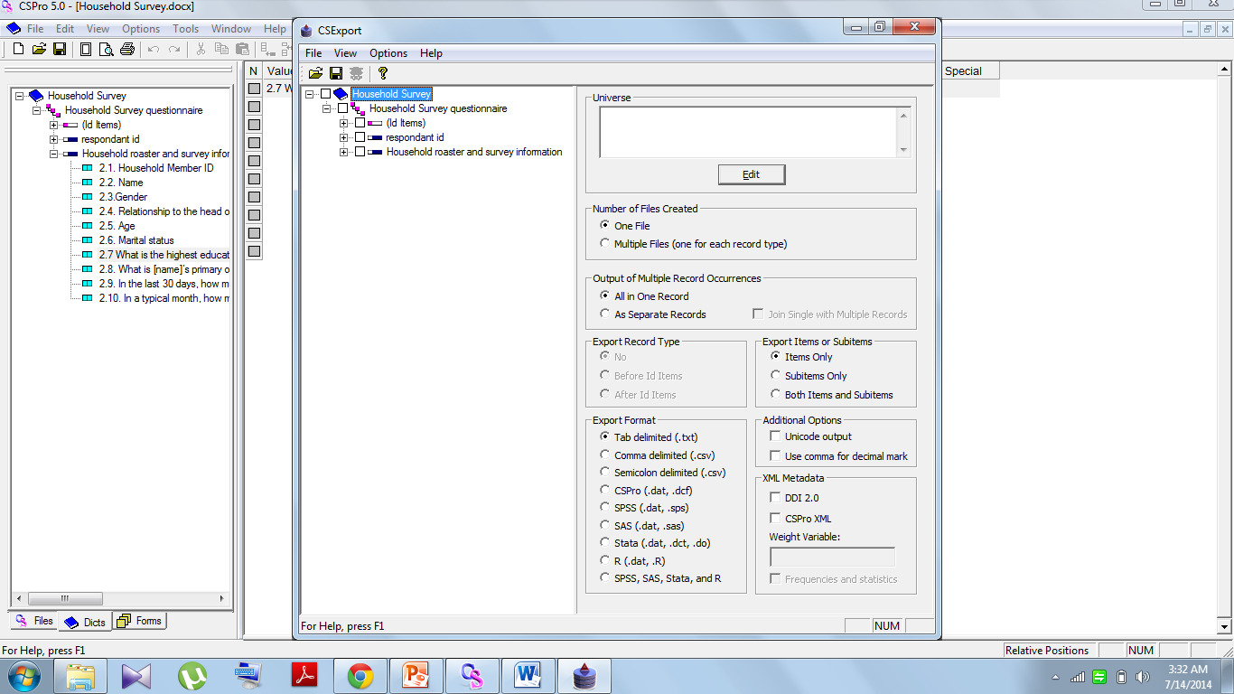
Different export format options

Slide 16
We can use more tools like http://www.csprousers.org/2013/04/22/operator-statistics-viewer/ for further analysis.

